Slide 1
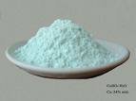
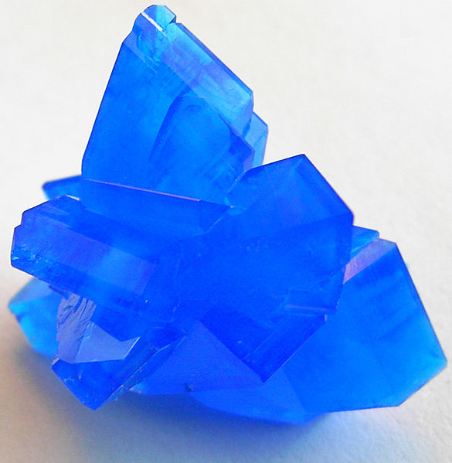
Lab 4: Investigating Hydrates (Turn oven on)
Crystals of ionic compounds (salts) often have water molecules weakly bound in their lattice structure
These are called hydrates; the water is shown as part of the formula: CuSO₄. 5H₂O
Copper (II) sulfate, CuSO₄
Add 5 water molecules
Copper (II) sulfate pentahydrate
CuSO₄.5H₂O
Anhydrous: without water

Slide 2
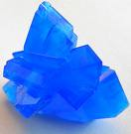
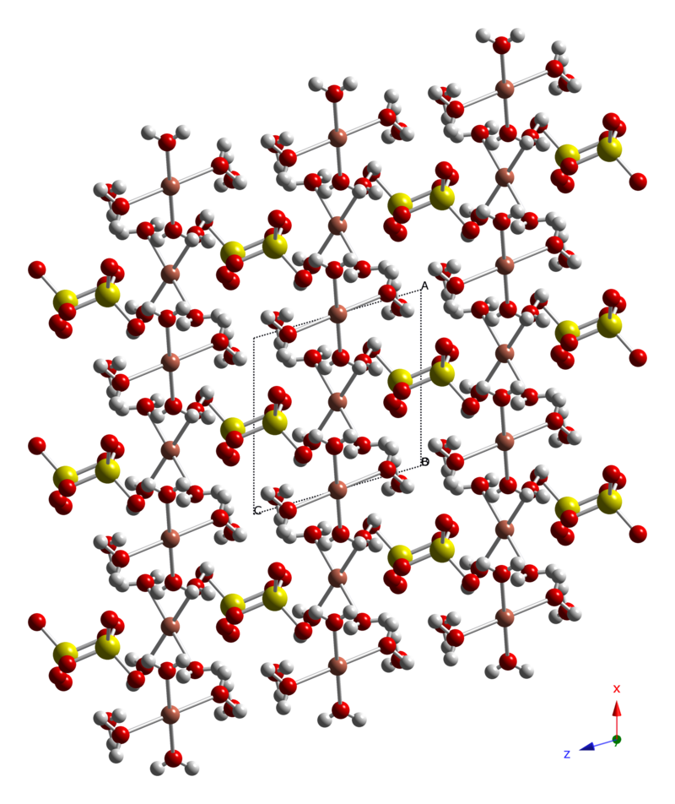
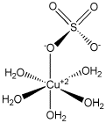
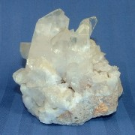
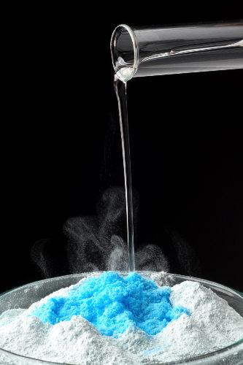
Copper (II) Sulfate Pentahydrate
Copper (II) Sulfate Pentahydrate Crystalline Lattice
Rehydration

Slide 3
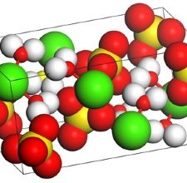
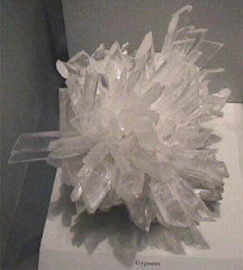
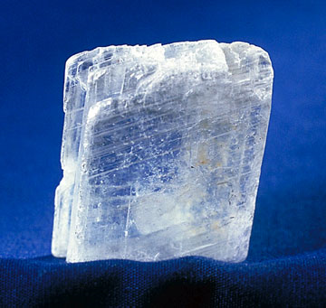
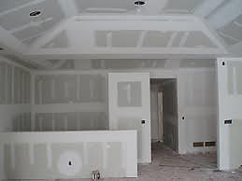
Gypsum:
formula?
Name?
CaSO₄•2H₂O

Slide 4
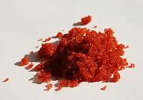
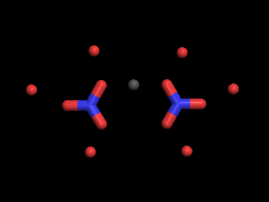
Cobalt (II) Nitrate Hexahydrate
formula?
Co(NO₃)₂ ∙ 6H₂O

Slide 5
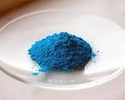
More About Hydrates
If we weigh a hydrate sample, then evaporate the water by heating, we can determine the mass and % of water lost by the difference in the mass of the sample and residue
The mass % water is 7.20 g H₂O x 100 = 41.1% H₂O
17.52 g hydrate
+
17.52 g
Hydrate
10.32 g
Anhydrous salt (residue)
7.20 g H₂O lost

Slide 6
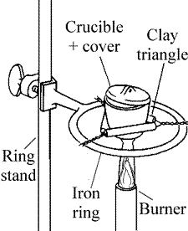
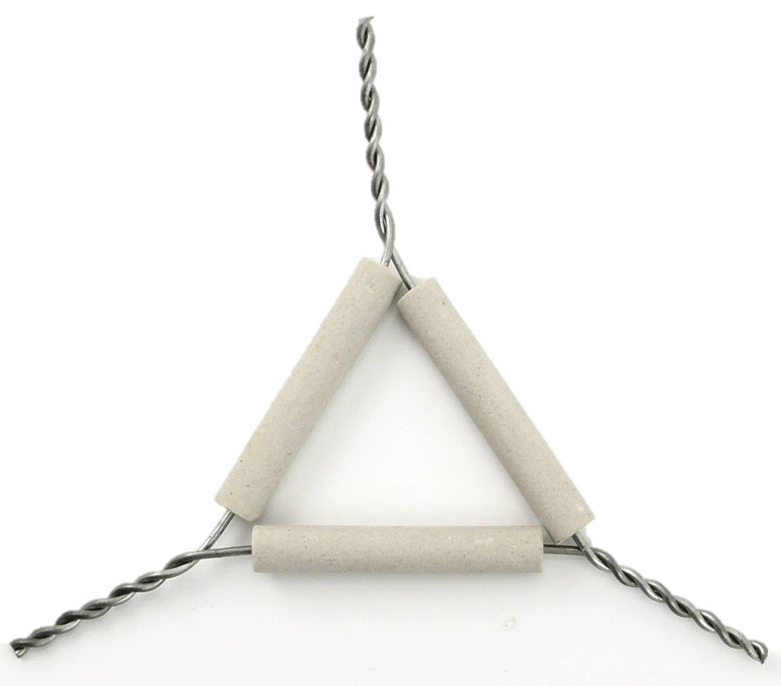
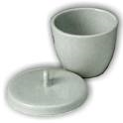
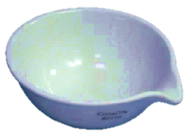
Today’s Procedure
Work with a partner, but both need set-up
Each does 1 trial of the same unknown
Clean dry crucible *
Crucible tongs
Clay Triangle
Label and put a clean crucible in the oven
After lab lecture; let it cool, weigh it /record mass (all digits)
Add about 2 g (weigh to 0.001 g) of one of the unknown hydrates (record ID #) to crucible and record the mass of crucible + hydrate on the same balance (all digits).
⊘
Crucible ⟹
*Get an extra crucible and lid from the back bench

Slide 7
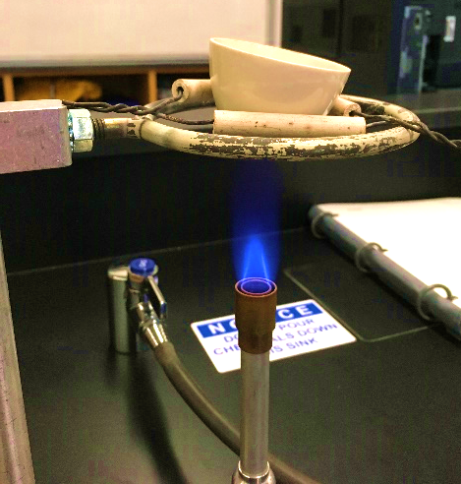
Today’s Procedure : Heating the hydrate
Adjust ring to be ~3.5 inches above burner (use ruler)
Place crucible with hydrate on clay triangle at a slight angle and gently heat for 5 min (no popping/splattering)
After 5 min, adjust flame only (make it a little stronger)
Heat more until crucible bottom turns
slightly red; heat for 15 more min.
Allow crucible to cool (wire gauze)
Using crucible tongs transfer it to balance. Weigh and record mass of crucible + residue. (same balance)

Slide 8
Calculating Theoretical Mass % from a Formula
For copper (II) sulfate pentahydrate, CuSO₄. 5H₂O:
Calculate molar mass of ionic compound + water:
Cu 63.55 x 1 = 63.55
S 32.07 x 1 = 32.07
4 O 16.00 x 4 = 64.00
5 H₂O 18.02 x 5 = 90.05
Molar mass of CuSO₄. 5H₂O 249.72
Theoretical mass % water = mass of water in 1 mol hydrate x 100% = 90.05 x 100% = 36.06%
molar mass of hydrate 249.72
Experimental mass % water = mass of water lost x 100 = x.xxx = ______%
mass of hydrate ~2 g
Percent error = (experimental mass % - theoretical mass %) x 100
theoretical mass %
CuSO₄ Molar mass: 159.62
Sig Fig Trap
costs 0.5 pts today!

Slide 9
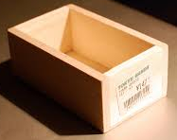
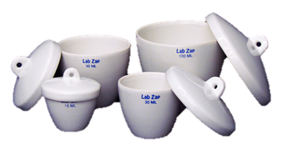
Today’s Procedure: Disposal, Clean-up and Beyond
Discard crucible contents into labeled container in hood
Clean crucible and lid and put away equipment .
Return extra crucibles to wood box

Slide 10
Calculations, Conclusions and Post-Lab
Keep balance areas clean
Clean up your equipment, etc. and then complete discussion questions.
Goggles on until everyone’s finished with the experiment and clean-up.
Work on theoretical mass % water and discussion questions ( 1a, 2,3,4) while waiting for heating/cooling
Show set-up so you can keep track of sig figs.
Round atomic masses to 2 decimal place
Complete discussion questions prior to leaving and get my sign-off (Thursday lab: sign off next week in lab)

